Slide 1
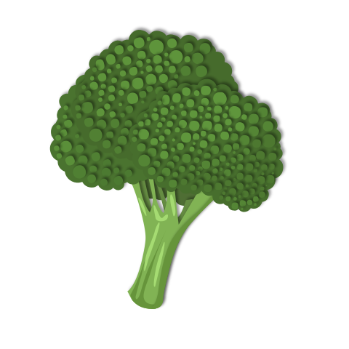

What’s on the menu?
Analyzing Food.com recipes to predict cuisine

Slide 2

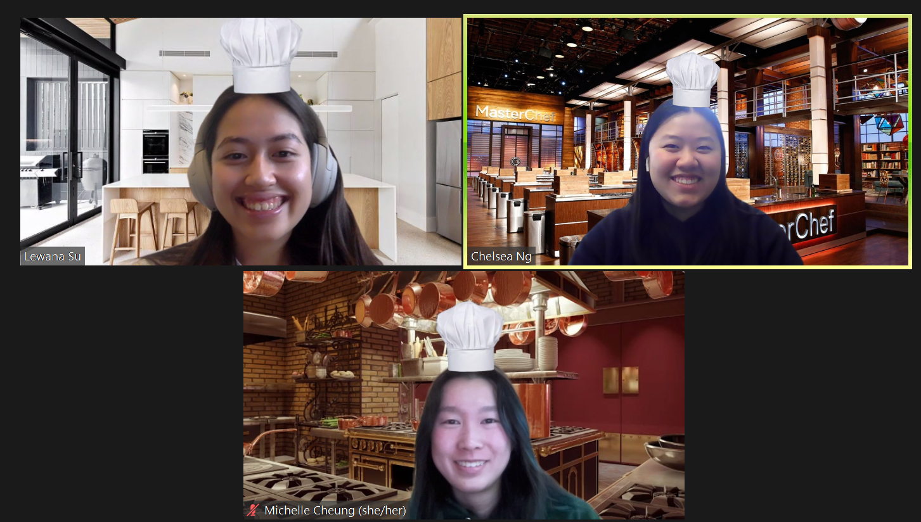
Meet the Chefs
Michelle Cheung B.A. Data Science
Chelsea Ng B.A. Economics
Lewana Su B.A. Data Science

Slide 3
Today’s Specials
Introduction and Background
Dataset and Cleaning
Methods and Troubleshooting
Results and Conclusions

Slide 4
01
Introduction and Background

Slide 5










Project Goal & Motivation
Build a classification model that identifies cuisine type, given a set of ingredients and other features, such as nutritional value, cook time, etc.
Optimize grocery shopping
Find common ingredients/staples across different cuisines
Reduce food waste
Alternative uses to ingredients sitting in your pantry
“Gordon Ramsay’s Chicken Tikka Masala”
Cuisine: Indian

Slide 6
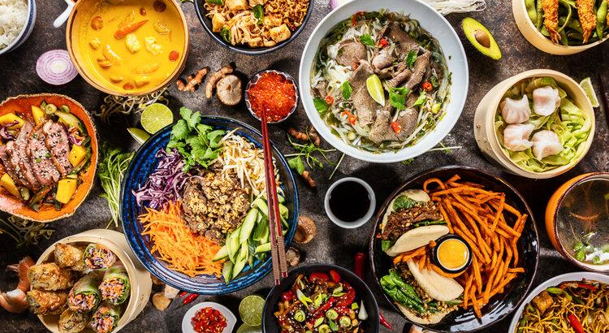

How can we classify a cuisine based on Food.com recipe data?

Slide 7
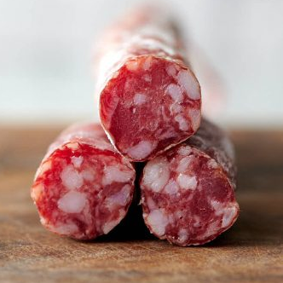
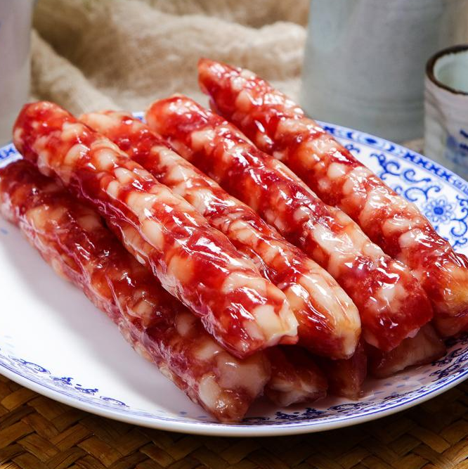
Factors to Consider
lean pork meat
coppa
pork back fat
water
garlic minced
kosher salt
granulated sugar
white wine
ground white pepper
hog casings
fatty pork
lean pork
salt
sugar
Chinese baijiu or rosé wine
ground peppercorns
pink salt
MSG
hog casings
User-created content not verified
What cuisines are most and least represented in the dataset? Difficulty in classifying cuisines that aren’t well represented
Recipes that share a good majority of ingredients
Cuisine: Spanish
Cuisine: Cantonese
Notes:
4 lb fatty pork
6 lb lean pork
2 tablespoons salt
1 cup sugar
¾ cup Chinese baijiu or rosé wine
2 tablespoons Sichuan pepper ground or whole peppercorns
4 tablespoons pink salt
1 teaspoon MSG
1 tablespoon red rice yeast
3 oz. chili powder (or more to taste)
3 cloves garlic pressed
2 tablespoons grated ginger (or galangal)
1 teaspoon freshly grated nutmeg

Slide 8
02
Dataset and Cleaning
Notes:
Describe the raw dataset (where or how did you collect it, descriptives, feature engineering, filtering, etc)

Slide 9
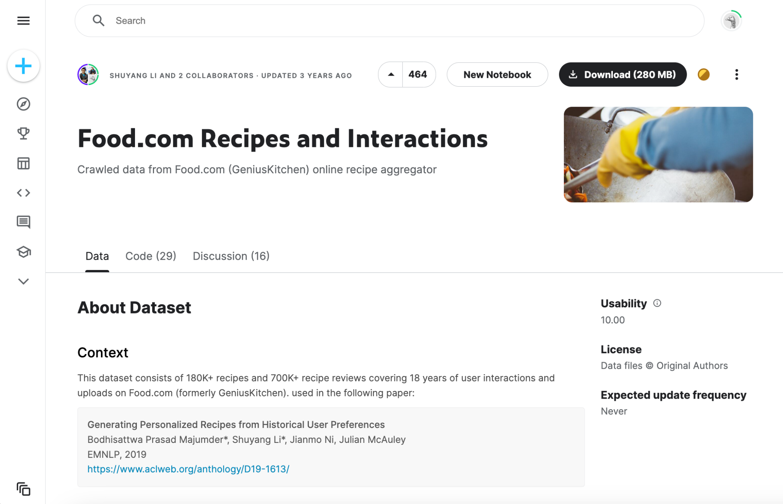
Data Set
Notes:
We collected our data set from Kaggle. This dataset consists of 180K+ recipes covering 18 years of user interactions and uploads on Food.com (formerly GeniusKitchen).

Slide 10
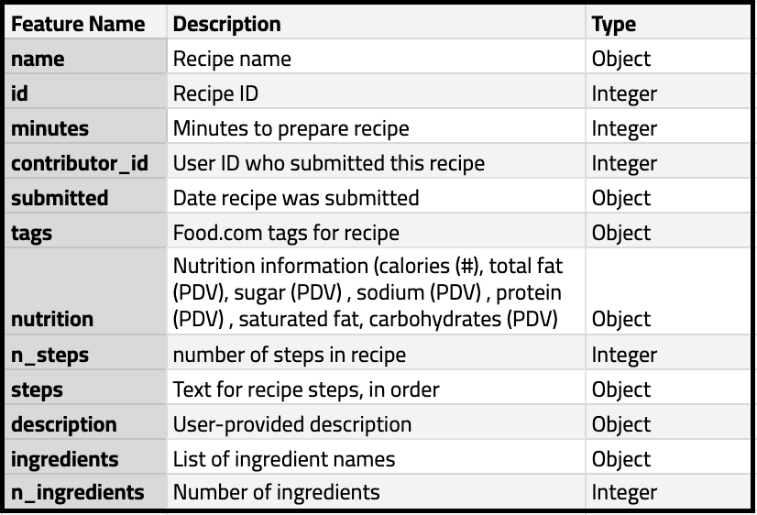

Features

Slide 11
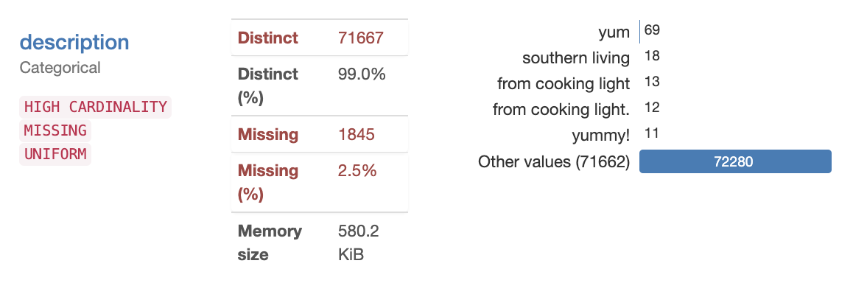
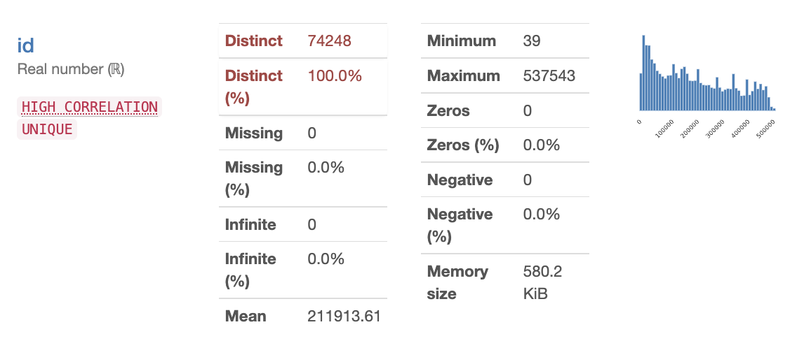
Data Cleaning & Preprocessing
Dropped columns
Dropped the following features – name, id, contributor_id, submitted, steps, description – due to lack of significance, high cardinality, or high correlation (multicollinearity)
Notes:
Dropped features: name, id, contributor_id, submitted, steps, description

Slide 12
Data Cleaning & Preprocessing
Target Feature (Cuisine)
Nutrition Columns
Remove Common Ingredients
Find a list of country cuisines and cross-check with “tags”
Create column for “cuisine”
Drop columns that don’t have a cuisine
Extract values from lists in “nutrition”
Create columns corresponding to: calories, total fat, sugar, sodium, protein , saturated fat, carbohydrates
Find the top common ingredients
Remove common ingredients from “ingredients” list
Notes:
Creating target features -> Tags: Find a list of country cuisines and cross-check it with tags
Then create a column with cuisine
Drop columns that don’t have a cuisine
Create new columns for each nutritional category
Cleaning: Find the top common ingredients and take it out from each recipe

Slide 13
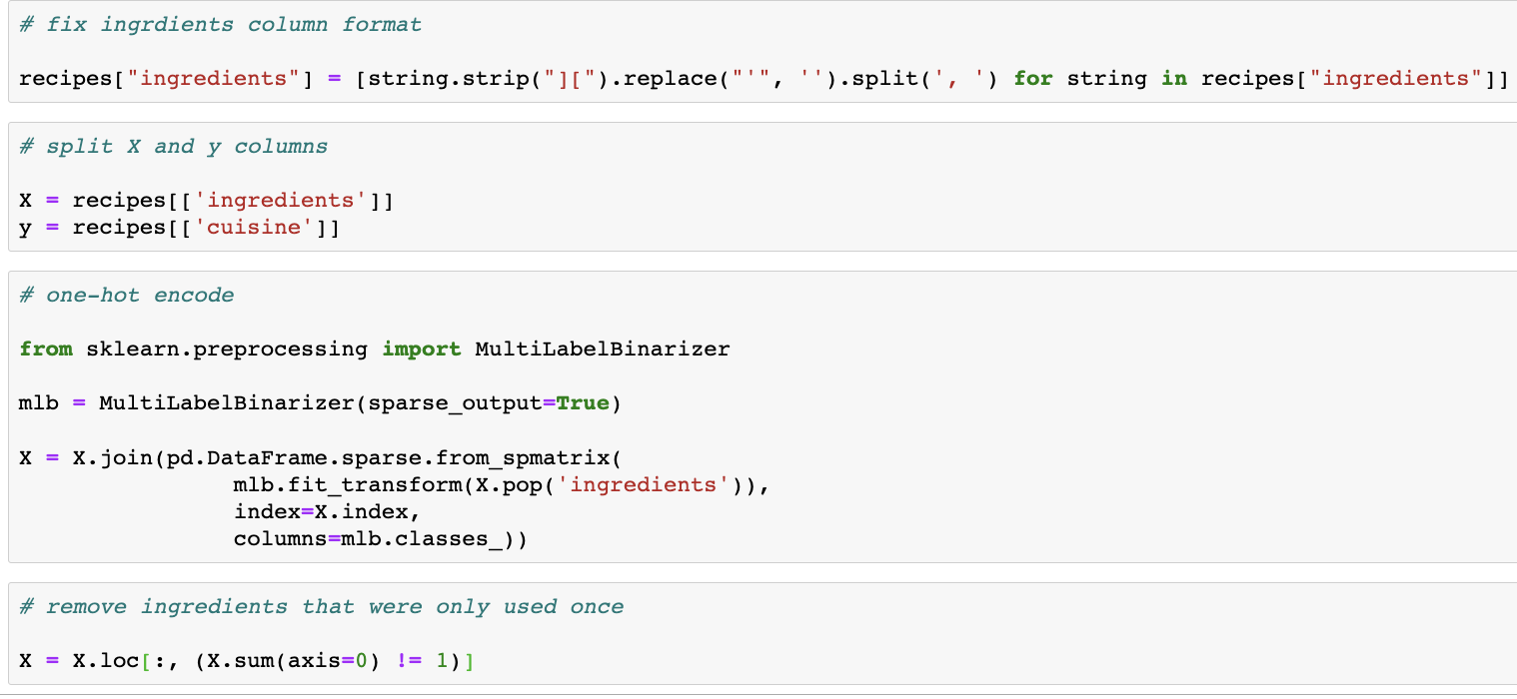
Data Cleaning & Preprocessing
One-hot encoding Ingredients
Before and After
Initial dataframe dimensions:
230,186 rows
12 columns
Final dataframe dimensions:
74,248 rows
7,953 columns
Extract ingredients from list
One-hot encode ingredients
Remove ingredients that were only used once
Notes:
Ingredients: extract from list, one-hot encode, remove ingredients that were only used once
Initial dataframe dimensions: 230186 rows, 12 columns
Final dataframe dimensions: 74248 rows, 7953 columns

Slide 14
03
Methods and Troubleshooting
Notes:
So Moving on to model training methods and troubleshooting

Slide 15



Training the Model
# of ingredients
ingredient list
sugar
carbohydrates
# of steps
protein
calories
sodium
cook time
saturated fat
total fat
Comparing a model using only the ingredient list with one that uses all the features above, we realized that the first model was more accurate.
Notes:
Original idea ….. train model using all …… (which includes nutritional data such as sugar ……& fat levels , # ing/steps/minutes, and the entire ingredient list)
However, after comparing 2 models with the exact same parameters…..one of which used only the ingredient list, ..v vs all … so all our models were trained using ingredients only

Slide 16
Models Used
cook time
 | Test Set Accuracy
Logistic Regression | 0.584332
Neural Network | 0.573917
Random Forest | 0.504332
CART | 0.504108
Baseline | 0.415533
Notes:
We tried and compared 5 types of models, ranked in order of decreasing accuracy on the test set…… with logistic regression yielding the highest test set accuracy of 58.4%

Slide 17
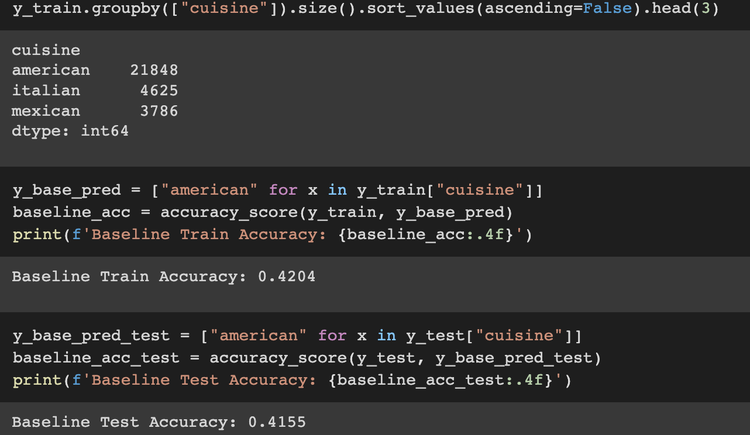
Models Used
cook time
Baseline
The majority of our recipes were dishes from American cuisine, and having the model predict ‘American’ regardless of ingredients yielded an accuracy of 41.6% on the test set.
Notes:
As you can see in the code below, around 40% of teh recipes in our dataset are labeled as

Slide 18
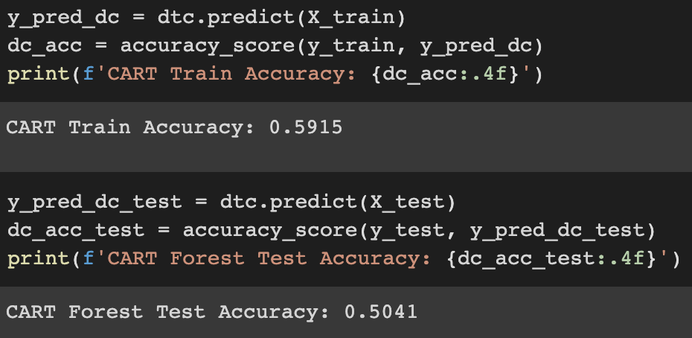
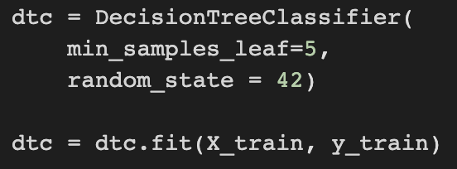
Models Used
cook time
CART
Using a decision tree classifier and adjusting the min_samples_leaf & max_depth hyperparameters, we trained a model with an accuracy of 50.4% on the test set, slightly better than the baseline.

Slide 19
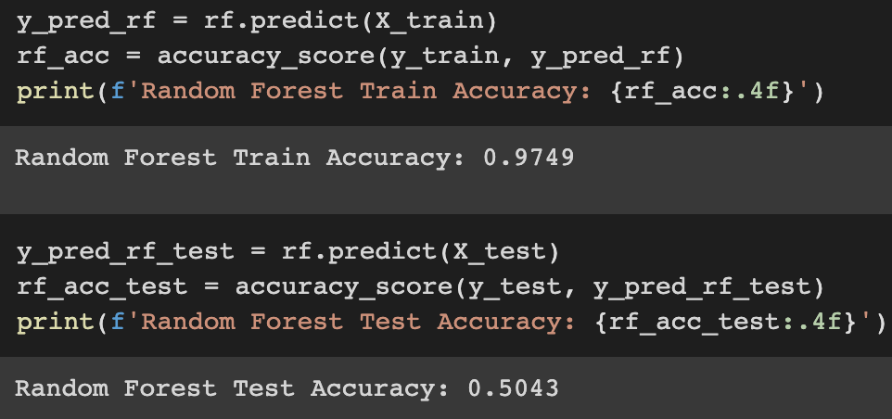
Models Used
cook time
Random Forest
With a random forest classifier model, we achieved a high training accuracy of 97.5%, but a test accuracy of 50.4%, similar to the previous model.
Notes:
97.5% .. which could be due to overfitting as our test accuracy ….

Slide 20
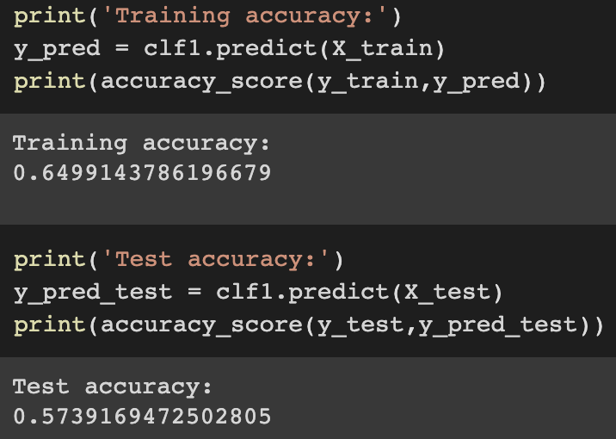
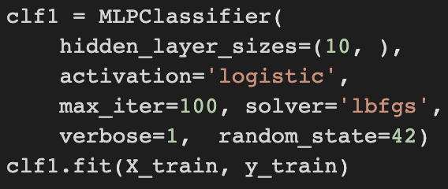
Models Used
cook time
Neural Network
Tuning the hidden_layer_sizes, activation, and max_iter of a MLP neural network classifier, we trained a model with significantly higher test accuracy than the last two, 57.4%.

Slide 21
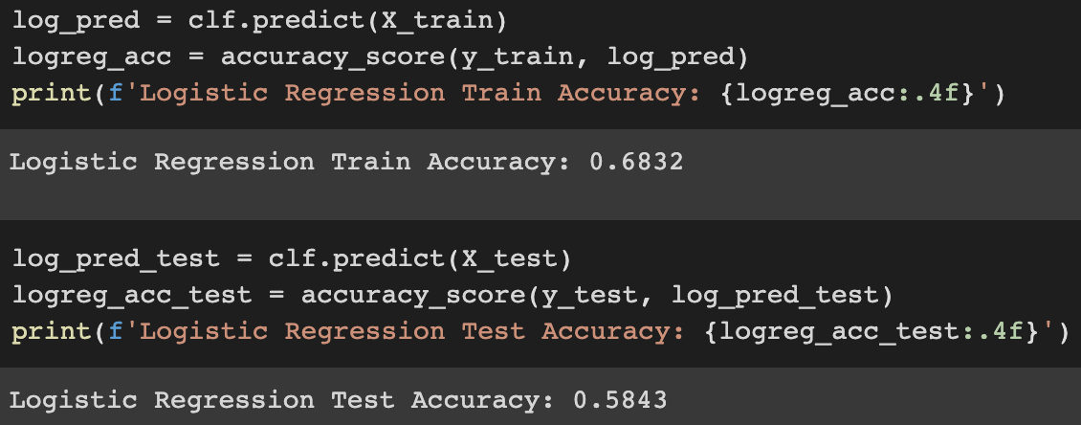
Models Used
cook time
Logistic Regression
The logistic regression model yielded the highest accuracy on the test set, which was 58.4%.
Notes:
Our last and most accurate model was log reg …

Slide 22
04
Results and Conclusions
Notes:
After finishing model training and exploring our data a bit more …. Found some interesting observations & results!

Slide 23



Cuisine Leaderboard
Most Sodium
Most Sugar
Most Carbs
Korean cuisine avg recipe has 68.3 PDV
Scottish cuisine avg recipe has 137.7 PDV
Dutch cuisine avg recipe has 23.7 PDV
Notes:
Here we have …..
Based on the averages of various nutritional values of all the recipes in a certain cuisine, we found the cuisine that ranked highest in each category
Coming in first for most sodium ____, where each recipe, on average, covers 68.3% of the recommended daily value
for most sugar, we have ___

Slide 24


and the winner is…
Most Ingredients
Most Calories
Most Carbs
Most Protein
Nepalese cuisine
Notes:
One thing to consider about the leaderboard is that the results may be skewed based on what types recipes are in our dataset…. For ex…. if a certain cuisine happens to have more dessert recipes on food.com, it may be incorrectly listed as containing the highest levels of sugar which may not necessarily be true for the cuisine as a whole
With that said. .pass back to michelle for next steps

Slide 25
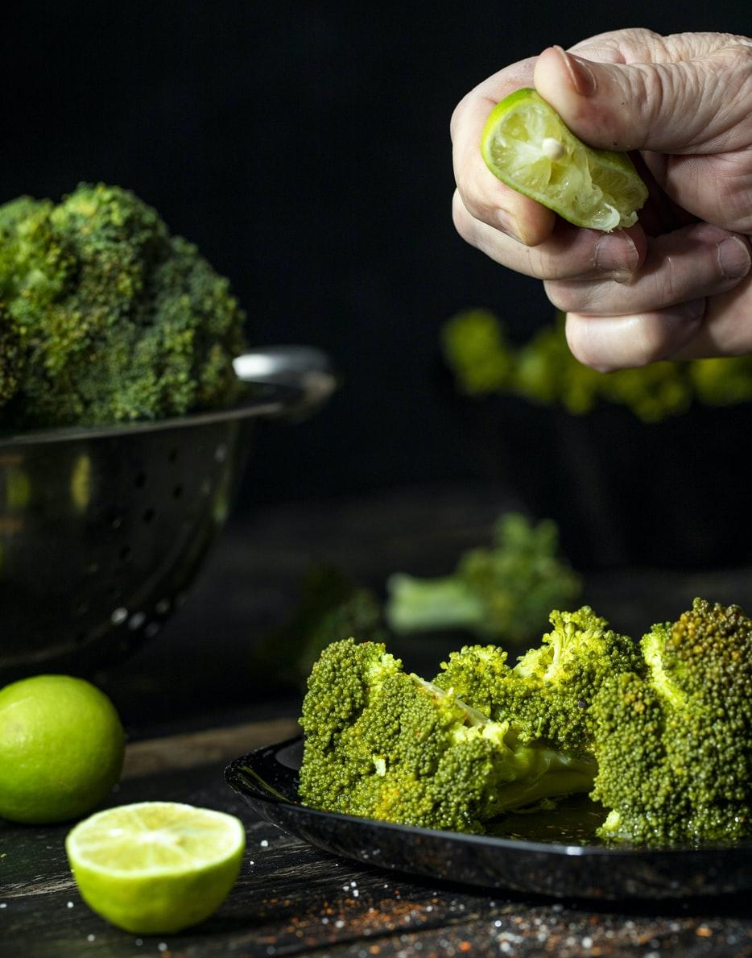

Next steps
In order for our model to be ready for real-world use, it needs more comprehensive recipe data from cuisines that are “lesser known” in America.

Slide 26
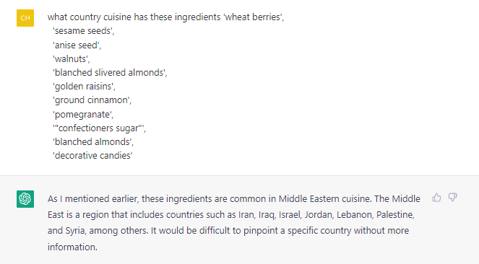
Our model vs ChatGPT
Our model correctly classified:
Cuisine: Greek
Notes:
Greek cuisine

Slide 27



Future Applications
“
Enhance Recipe Sites
Assist users with accurately tagging recipes and displaying other recipes that use the same ingredients
Reduce Food Waste
Accessibility
Make world cuisine and flavors for people with dietary restrictions
We hope to reduce food waste by recommending recipes based on what you HAVE vs NEED (similar to platforms like SuperCook and EmptyMyFridge)
Notes:
Enhance user experience on recipe sharing sites
Assist users with tagging recipes and displaying other recipes that use the same ingredients
Help reduce food waste by recommending recipes based on the inputting a list of ingredients you have at home (similar to platforms like SuperCook and EmptyMyFridge dietary restrictions taste the world
Make world cuisine accessible for people with dietary restrictions

Slide 28
Thanks for your order!
Thank you to the TAs who work tirelessly for us students! You are appreciated!

